Slide 1


SHE
BY Team Code_Demons

Slide 2
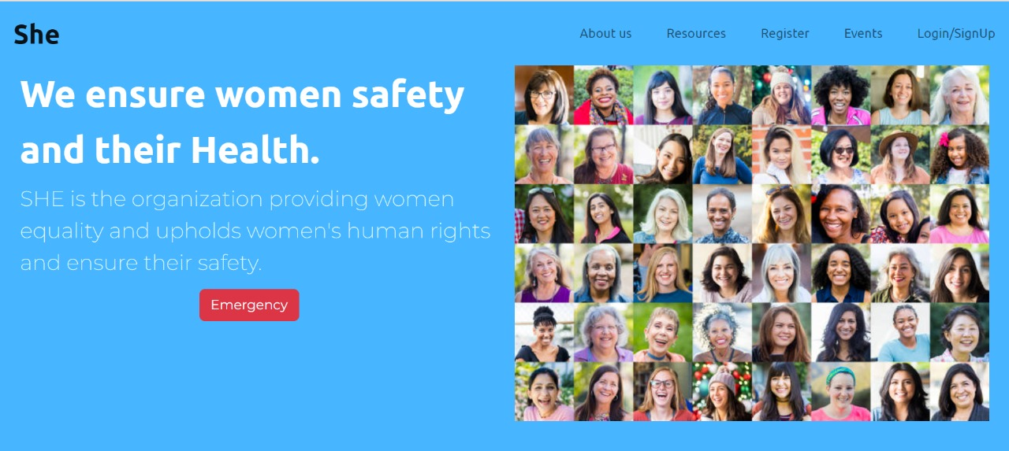

Slide 3


KEY FEATURES:
Register yourself and vail services like:
Distress SOS
Navigation Drawer
Access to live map and public transport locations.
A dedicated section for Women health and balanced diet.
Women helpline numbers of all localities.
Events Section to update about women empowerment drives and events by various organizations.
Get registered to She and be safe healthy and updated 24*7.

Slide 4
EXECUTION: SAFETY SECTION:
Platform will be functional 24*7 and act as a companion to Women in public places as well. The user will register to the website which will be a one time process and after this can avail all the features. Services include an automated distress SOS to the nearest police station and to her emergency contacts, not only this the app will also automatically send in distress signals to the nearby people within a specified radius with a live location. On the user app, there will be a navigation drawer which shall hold the basic details of the user and the screen other than that shall hold only one big button which shall be the panic button/Emergency button.
Emergency Button: On clicking this button the app sends in a distress message and a live location of the user to the nearest police station and to the ones selected as “close contacts”. The app will also send in a distress message and a live location link to all mobile phones then residing within a given radius from the location of the user. In case the user clicks the button while in a public transport, the system recognizes the vehicle and marks it red on the map which is being monitored by the police

Slide 5
Navigation Drawer: The user can change their basic information and add/change their close contacts in this drawer.
The concerned authorities will be operating using a web portal where they shall have access to the digital map for user locations and to monitor public transport locations and shall be authorized to view the live CCTV footage of any vehicle at any point of time. Police can acknowledge their arrival to a user when a distress call arises in their watch.
HEALTH AND FITNESS SECTION:
This section provides Women with the key ingredients of a balanced diet so that they can adjust their food routine accordingly.
Along with balanced diet ,it also provides details about various exercises and yoga asanas that a woman should perform regularly to ensure physical and mental fitness.
There is a dedicated section for events to update women regarding various self defense, physical fitness and yoga camps being organized in their localities.

Slide 6
Back-End Explanation
There is SOS alert when the user clicks the emergency button ,it send call to all the 4 emergency contacts and nearby police station . This data is also stored in a database explaining how many time user have used the SOS service. The four emergency contact details are stored in a database along with all the user information which they have submitted during registration.

Slide 7
FUTURE SCOPE:
We are planning to develop a multi-platform functional application and website that will make it more convenient for the Women to call for help in case of emergency .
We are also planning to deliver a product that will resolve three major issues faced by women in India : Safety , Health and Unawareness.
In addition to this we are also ready to unite the citizens and the Police to work towards prevention of rising crimes against women in their locality.

